Slide 2
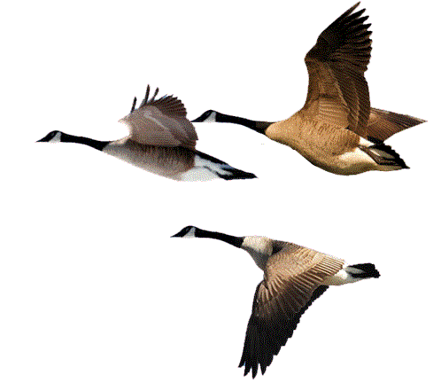
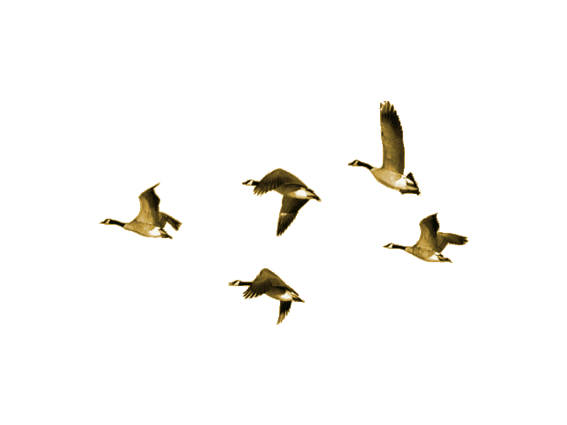
bagus

Slide 3
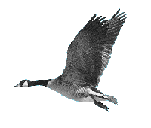
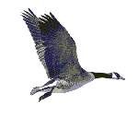
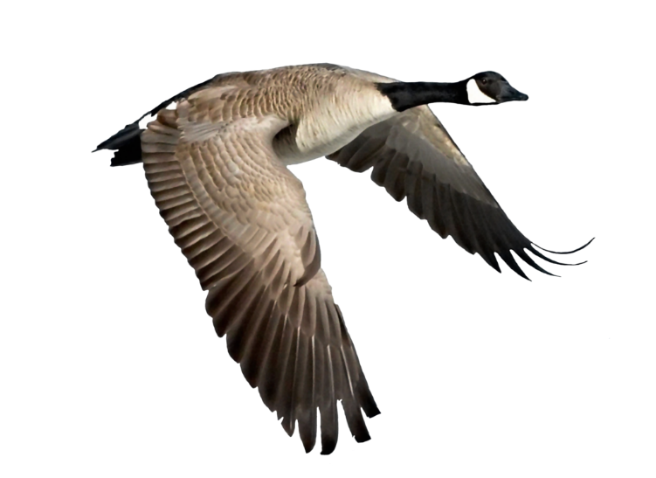
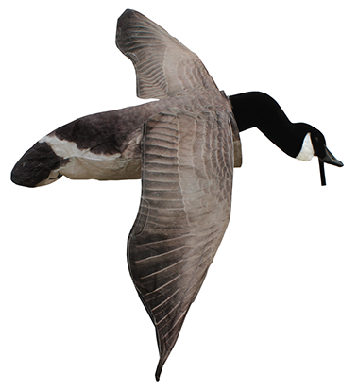
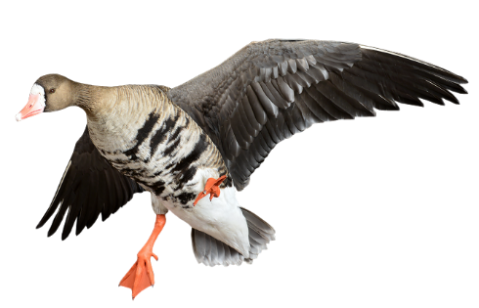
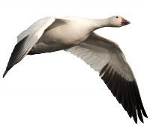
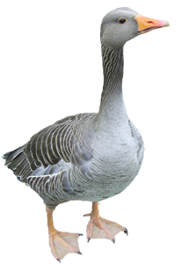
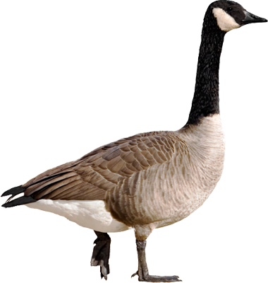
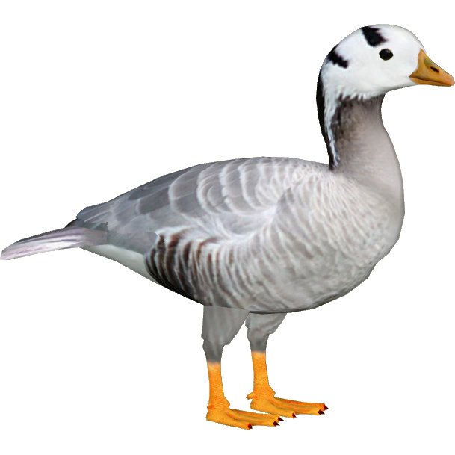
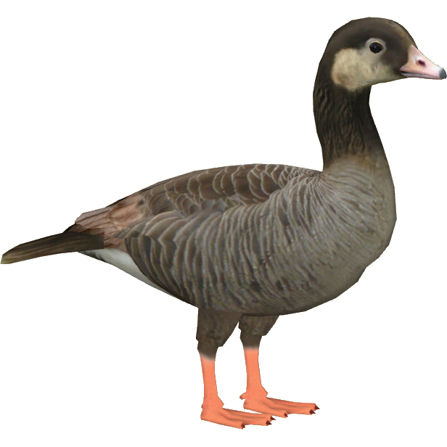
bagus
As you can see from the images there are many species of geese in the world, including the “bar-headed goose”!

Slide 4
bagus
Unfortunately, the word “bagus” has nothing to do with “geese” of any variety! You’d be a real “goose” if you thought that!
The adjective “bagus”, pronounced “bug-oos”, means “good” in Indonesian. It is probably the first Indonesian word that Aussies pick up (and never forget) when they go to Bali!

Slide 5
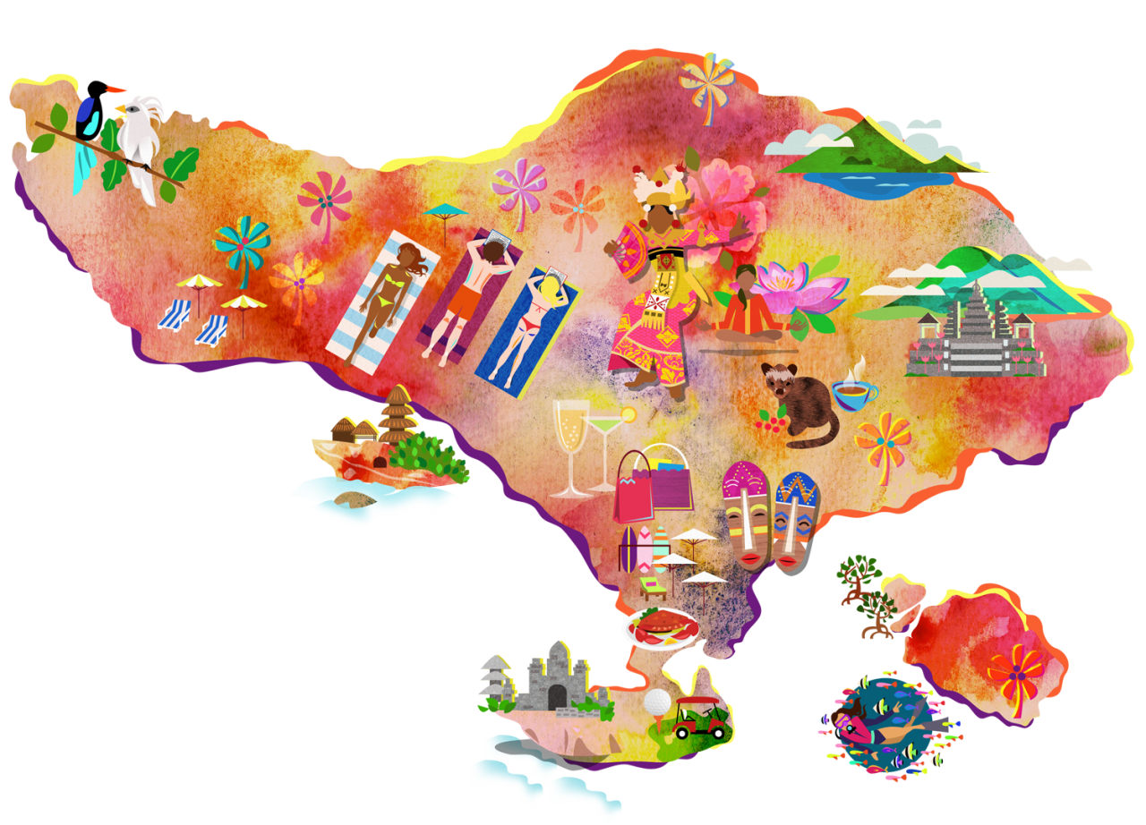
bagus
When visiting Bali, respect the local culture, speak a little Indonesian and you will be treated with warmth and respect by the locals!
Remember the old saying, “What’s ‘bagus’ for the goose, is ‘bagus’ for the gander” !

