Slide 2
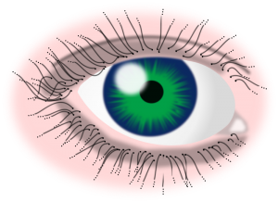
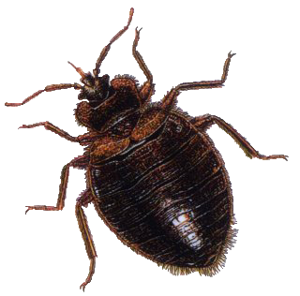
bagai

Slide 3
bagai
I’ll bet you’re thinking that “bagai”, pronounced “bug eye”, describes a medical condition where a parasite attacks the eye, right?
Actually, “bagai”, is a conjunction meaning “like” , “as if” or “as though” and is one of the methods used to create similes in Indonesian!

Slide 4
bagai
simile
I hope this WORD of the DAY has brought a to your face!
Personally, I find it as funny as The Three Stooges!

