Slide 2
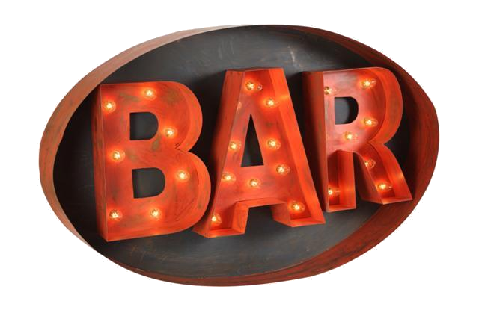
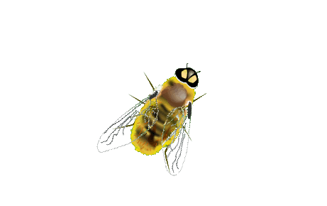
babi

Slide 3
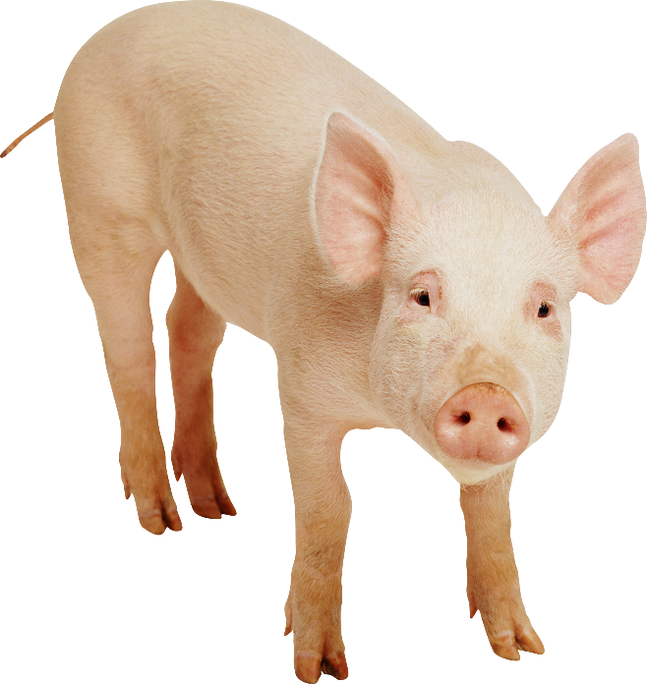
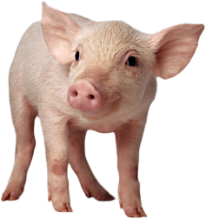
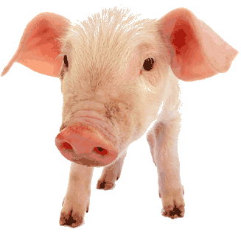
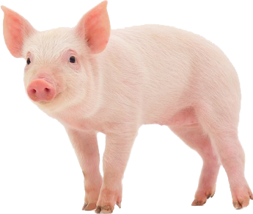
babi
No, “babi” , pronounced “bar-bee”, isn’t the word to describe bees attracted to a bar by the smell of stale beer!
“babi” is actually the Indonesian word for “pig” .

Slide 4
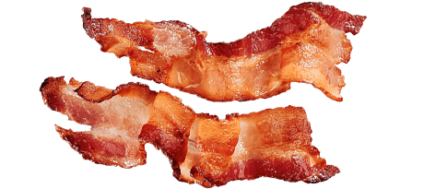
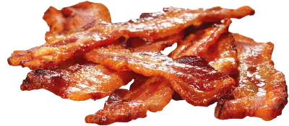
babi
Western people may view pigs as being cute and cuddly as well as the source of our breakfast bacon and hams, but for Muslim people pigs, along with all pig products, are considered “haram” and to be avoided at all costs.
Because of their beliefs, idioms such as “to bring home the bacon” are not appreciated by our Muslim brothers!

