Slide 1
Australia vs. Indonesia

Slide 2
Australia vs. Indonesia

Slide 3
Australia vs. Indonesia

Slide 4
Australia vs. Indonesia

Slide 5
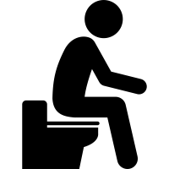
Australia vs. Indonesia

Slide 6
Australia vs. Indonesia

Slide 7
Australia vs. Indonesia

Slide 8
Australia vs. Indonesia

Slide 9
Australia vs. Indonesia

Slide 10
Australia vs. Indonesia

Slide 11
Australia vs. Indonesia

Slide 12
Australia vs. Indonesia

Slide 13
Australia vs. Indonesia

Slide 14
Australia vs. Indonesia

Slide 15
Australia vs. Indonesia

Slide 16
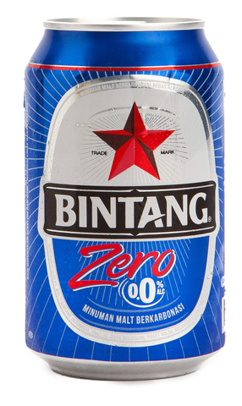
Australia vs. Indonesia

Slide 17
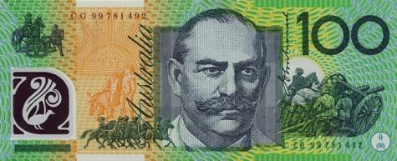
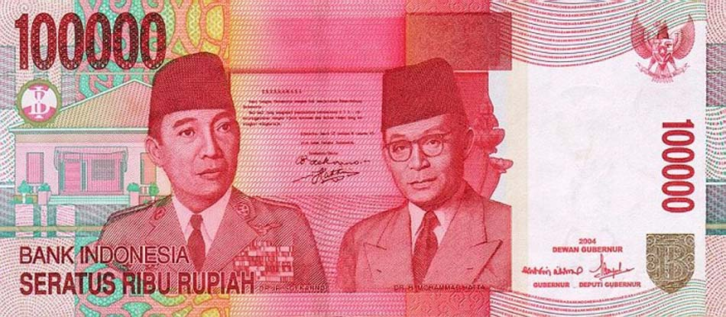
Australia vs. Indonesia

Slide 18
Australia vs. Indonesia

Slide 19
Australia vs. Indonesia

Slide 20
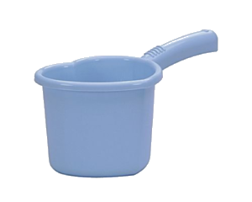
Australia vs. Indonesia

Slide 21
Australia vs. Indonesia

Slide 22
Australia vs. Indonesia

Slide 23
Australia vs. Indonesia

Slide 24
Australia vs. Indonesia

Slide 25
Australia vs. Indonesia

Slide 26
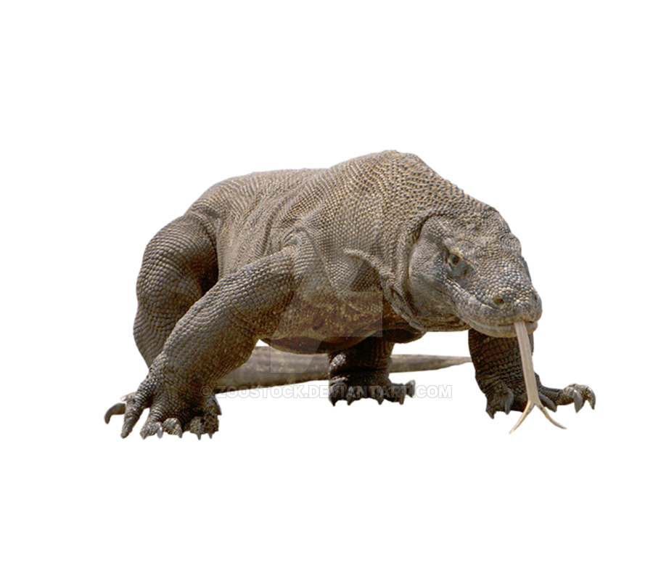
Australia vs. Indonesia

Slide 27
Australia vs. Indonesia

Slide 28
Australia vs. Indonesia

Slide 29
Australia vs. Indonesia

Slide 30
Australia vs. Indonesia

Slide 31
Australia vs. Indonesia

Slide 32
Australia vs. Indonesia

Slide 33
Australia vs. Indonesia

Slide 34
Australia vs. Indonesia

Slide 35
Australia vs. Indonesia

Slide 36
Australia vs. Indonesia
The End

