Slide 2
asam

Slide 3
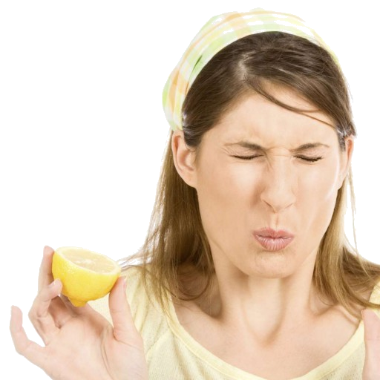
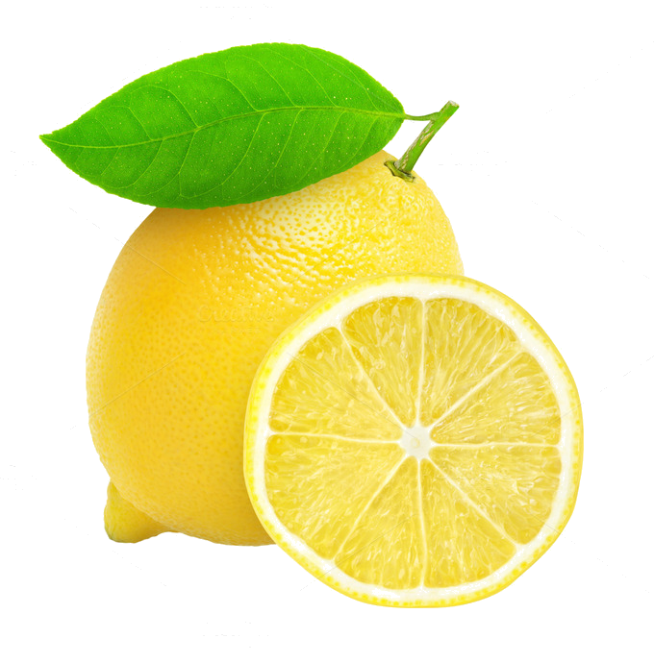
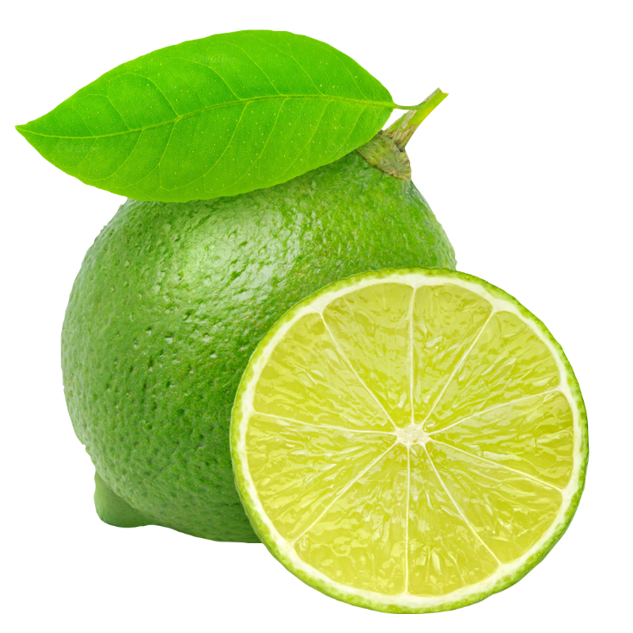
asam
I know what you’re thinking … “asam”, pronounced “a sum”, must mean a mathematical problem, right? As usual, you are WRONG!!!
The meaning of “asam” is actually “sour”.

Slide 4
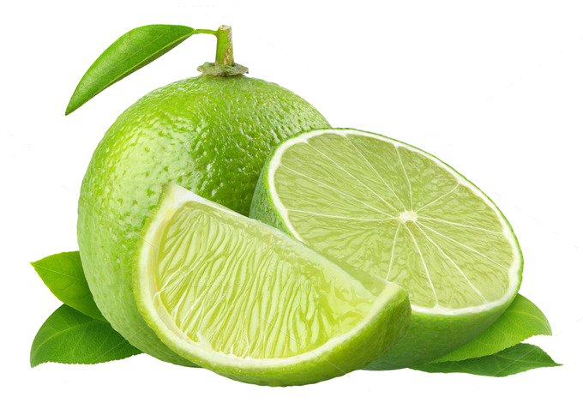
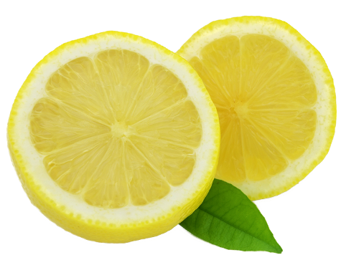
asam
I’ll bet “asam” of money that you can’t eat a whole lemon or lime. Don’t be “bitter” if you lose the bet!

