Slide 2
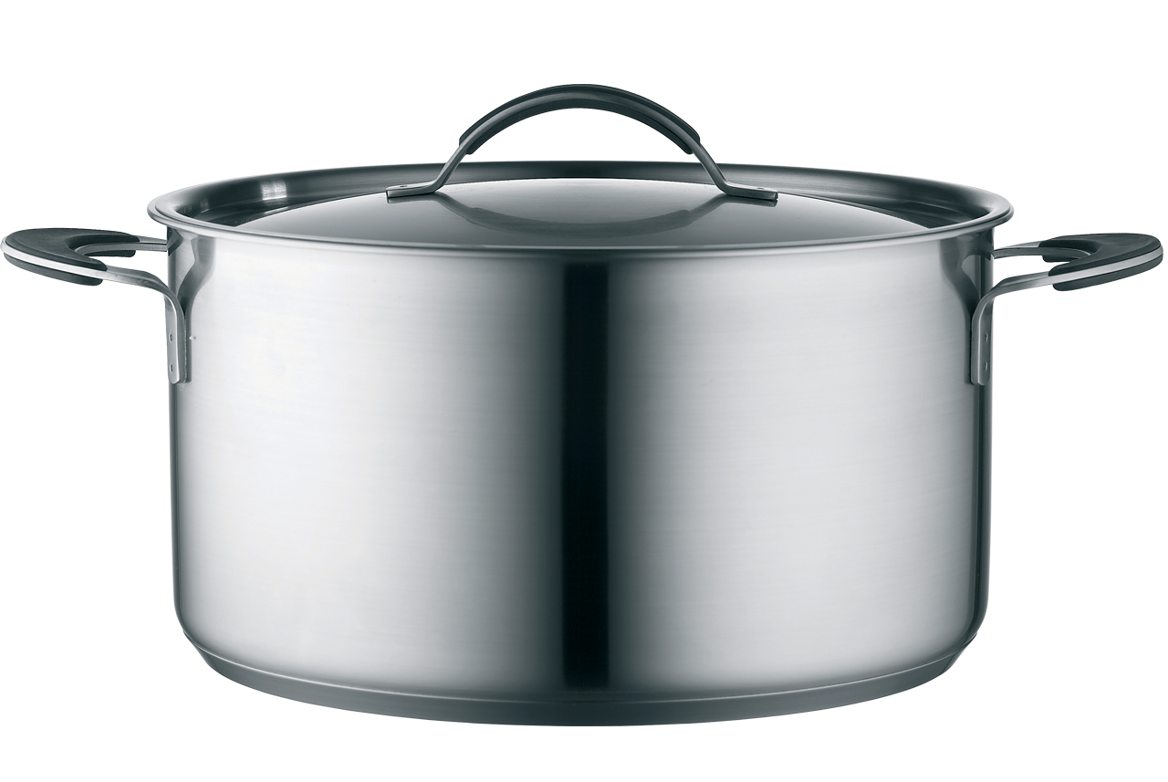
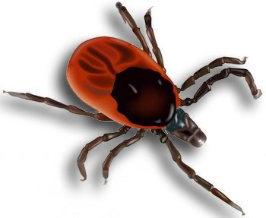
apotik
A

Slide 3
apotik
You would be forgiven for thinking that an “apotik” was a tick that was found in the pots of your kitchen cupboards.
In actual fact, an “apotik” is a “Pharmacy” or “Chemist” in Indonesian!

Slide 4
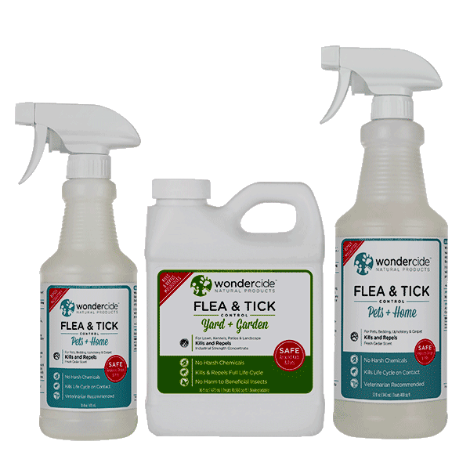
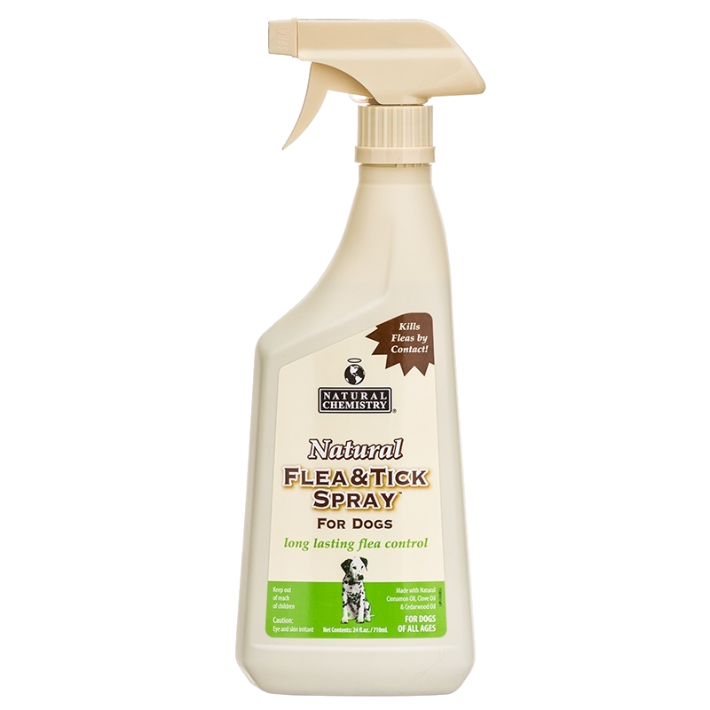
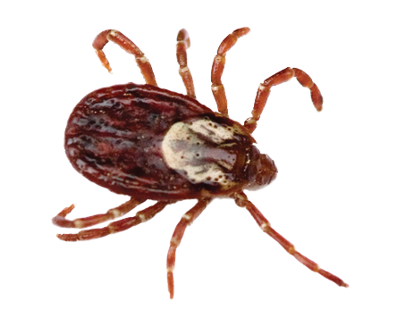
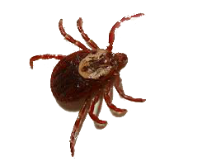
apotik
If you or your pets are attacked by ticks, go to your local “apotik” for advice. They will most certainly stock a number of remedies which get the “tick of approval” !

