Slide 2
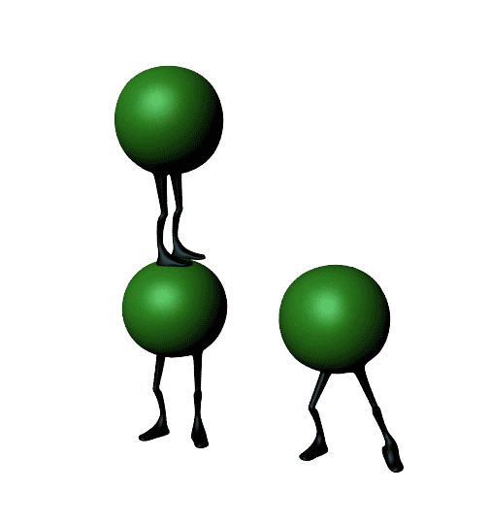
api

Slide 3
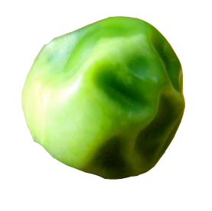
api
What a talented bunch of peas! However, if you think that the word “api”, pronounced “a-pea”, has anything to do with peas, then you must have a brain the size of a !!!
The noun “api” actually means “fire” or “flame” in Indonesian.

Slide 4
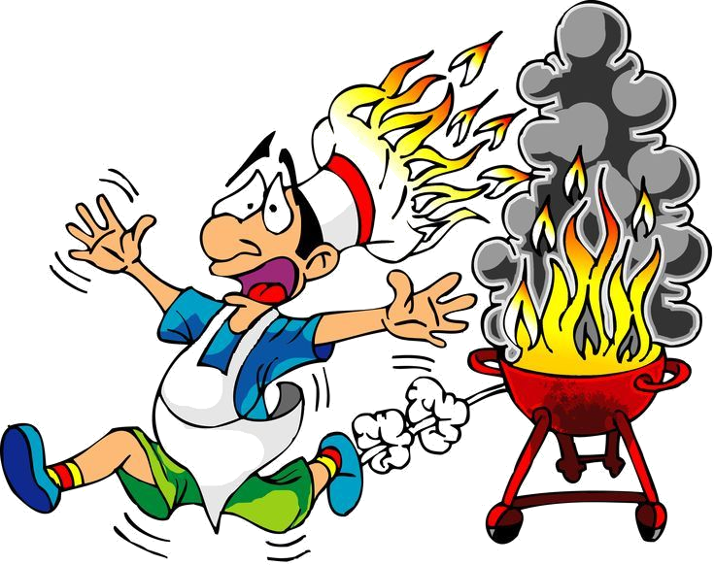
api
As the old saying goes, “If you play with fire, you are bound to get burnt.”

Slide 5
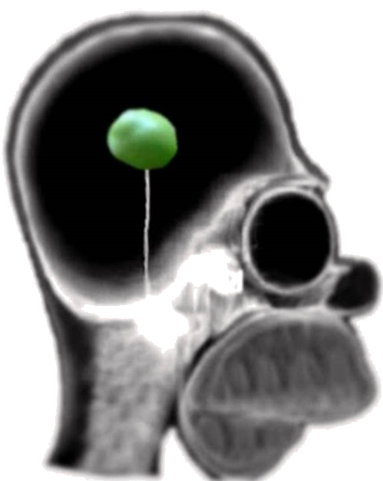
api
If you still don’t get the message, then you must be “api” brain!

