Slide 2
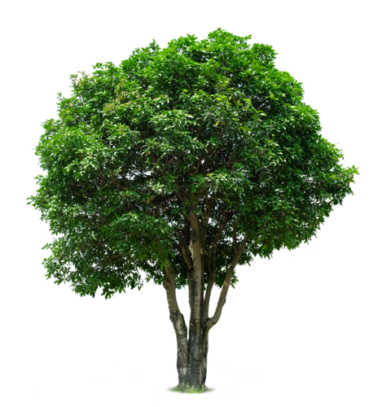
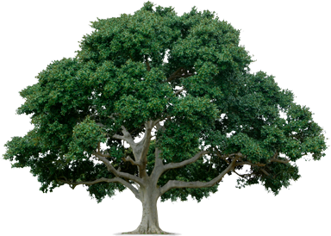
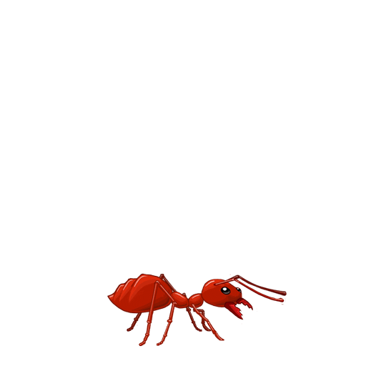
antri

Slide 3
antri
You probably think that the Indonesian word “antri”, pronounced “an-tree”, means “ants in a tree”, right?
Don’t get too carried away because, as usual, you out of line yet again!
The verb “antri” means “to form a line or queue” in Indonesian.

Slide 4
antri
Are you able to “antri” or have you got ants in your pants?

