Slide 1
Answering the Roll in Indonesian
The “Udder’ Way

Slide 2
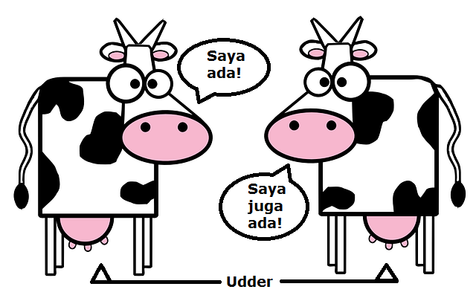
Are You Present?

