Slide 2
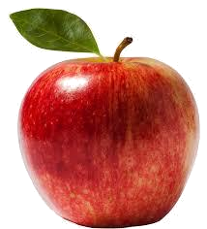
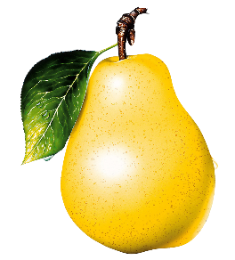
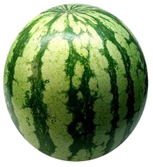
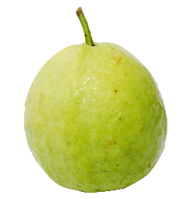
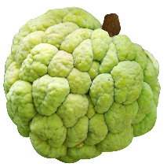
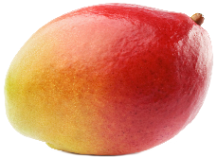
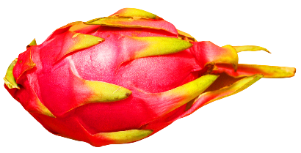
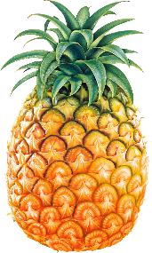
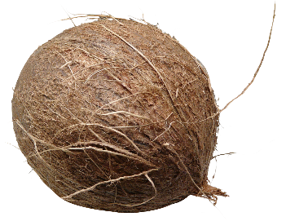
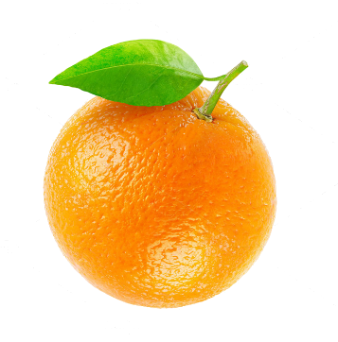
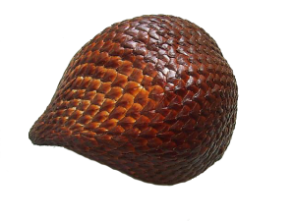
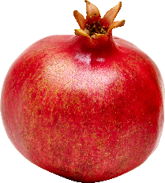
anak buah

Slide 3
anak buah
No, “anak buah” is not the family tree of a fruit salad! Translated word-for-word “anak buah”, pronounced “a-knuck boo-ah”, means “the children of fruit” .
However, in Indonesian, the expression “anak buah”, actually means the “faculty” or “staff” of any organisation. In that sense, it can be said that all of you are the “anak buah” or “fruit” of Browns Plains State High School.
Anak Buah

Slide 4
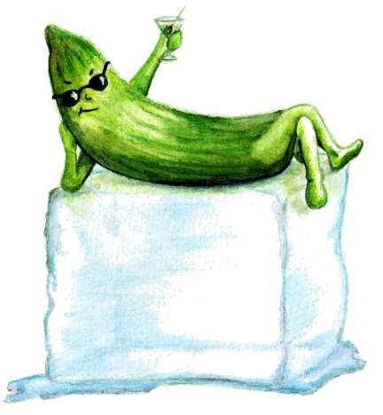
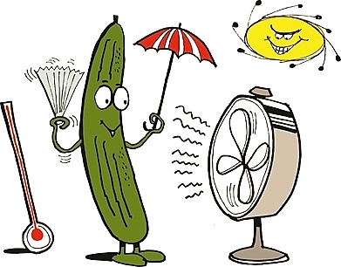
anak buah
Every school has its “bad or rotten apples”, its “annoying oranges” and its “top bananas” … what kind of fruit are you?
When it comes to teaching, I’m “as cool as a cucumber”!

