Slide 2
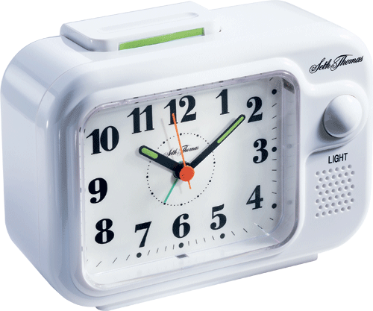
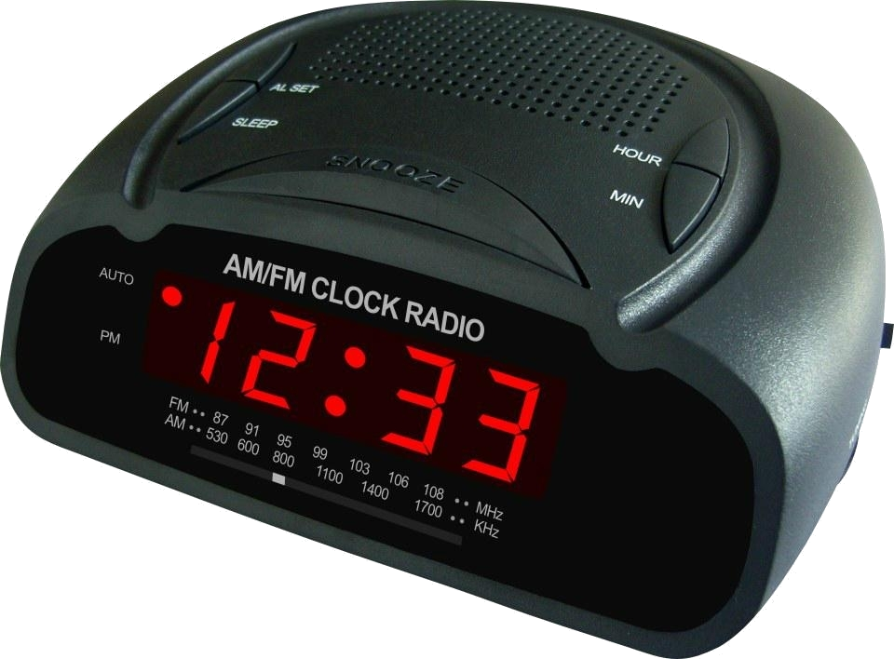
alam

Slide 3
alam
You are probably under the impression that “alam” means “alarm” in Indonesian.
Well, I don’t want to “alarm” you, but it doesn’t!
The noun “alam”, pronounced “a-lum”, means “nature” in Indonesian.

Slide 4
alam
As you know the “alam” bells on the environment have been ringing for some time. If we don’t act now on global problems such as climate change and deforestation, we will be living in a very different world in 50 year’s time.

Slide 5
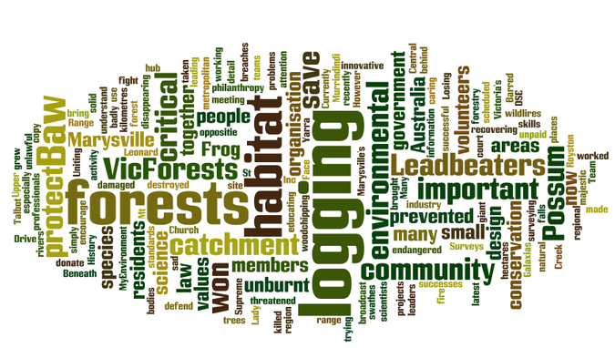
alam

Slide 6
alam

