Slide 2
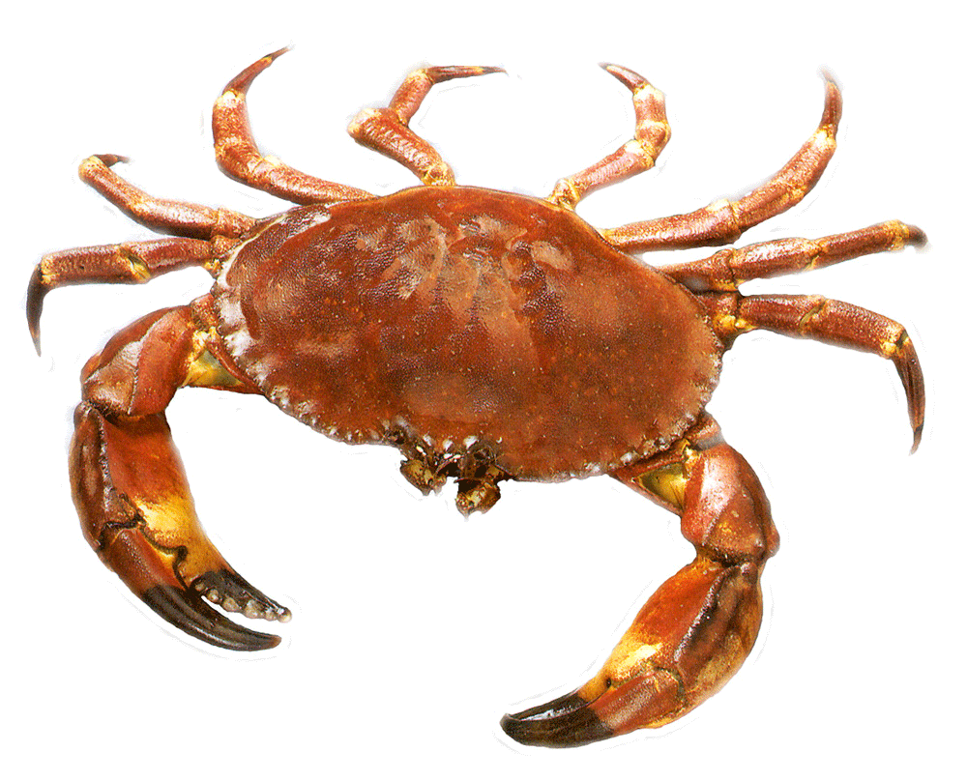
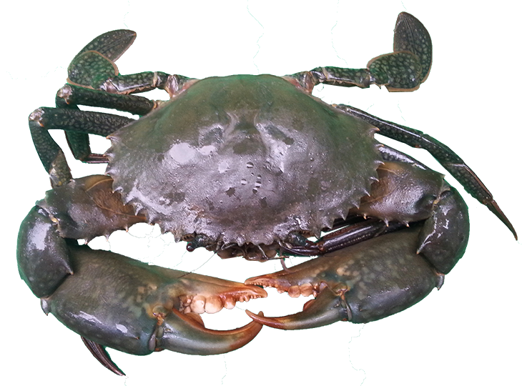
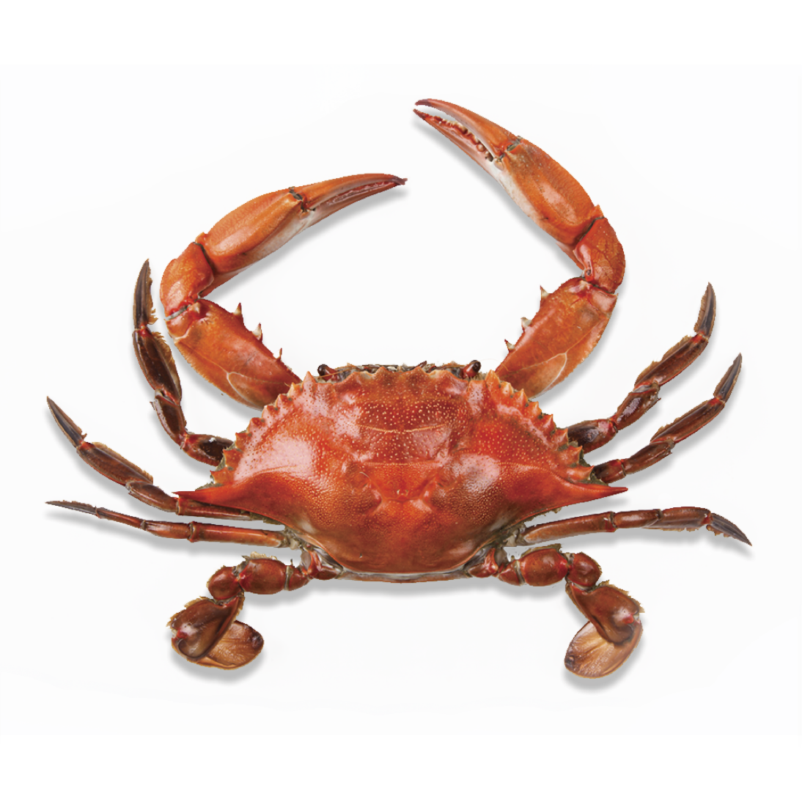
akrab

Slide 3
akrab
You are probably thinking that “akrab”, pronounced “a-krub”, means “crab” in Indonesian, right? After all, they say a picture is worth a thousand words!
Well, this time, I’m sorry to inform you that “akrab” is not a crab!
In Indonesian “akrab” is an adjective meaning “close” or “intimate” with regards to friendship.

Slide 4
akrab

Slide 5
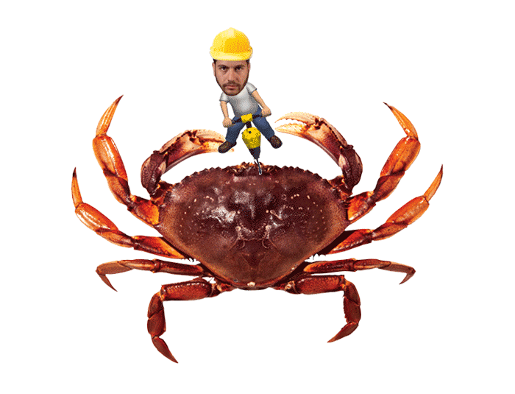
akrab
After years of experience, my advice to you, is never get “akrab” with a crab. You should ‘nip’ that relationship in the bud! There’s only one way to deal with a crab!

