Slide 2
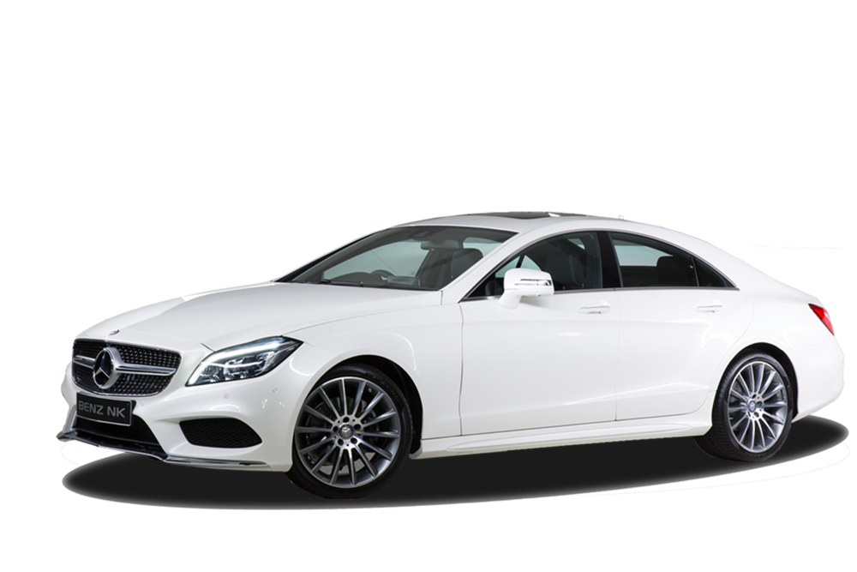
akar

Slide 3
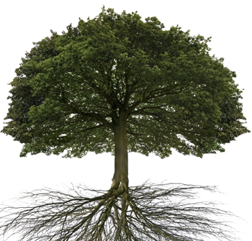
akar
Your are probably thinking that “akar”, pronounced “a-kar” is the Indonesian word for “a car”, right?
Because it looks like “a car” and sounds like “a car”, it doesn’t mean that it is “a car”!!!
The word “akar” actually means “root” or “roots” in Indonesian.

Slide 4
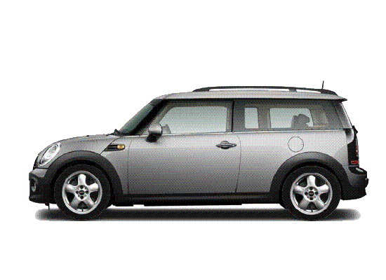
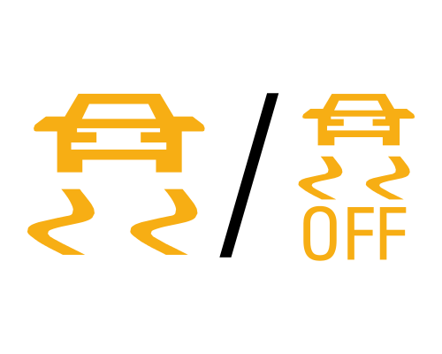
akar
These days most modern cars are fitted with Traction Control to make them safer.
When driving “a kar” don’t forget to engage the Traction Control so that your vehicle stays “rooted” to the road!

