Slide 2
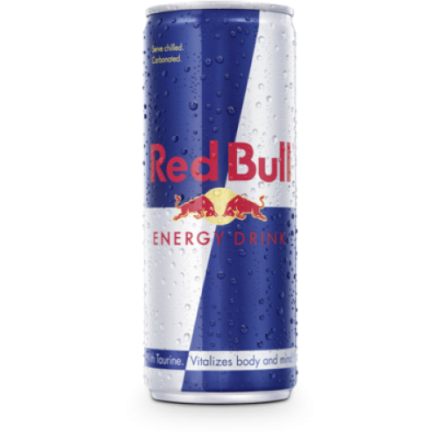
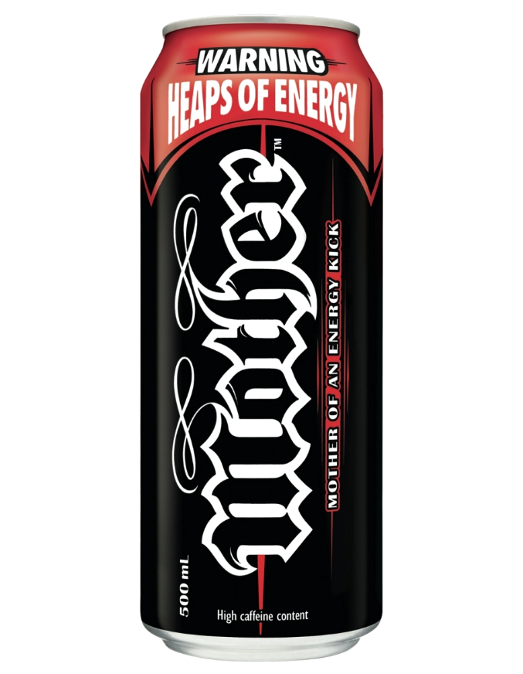
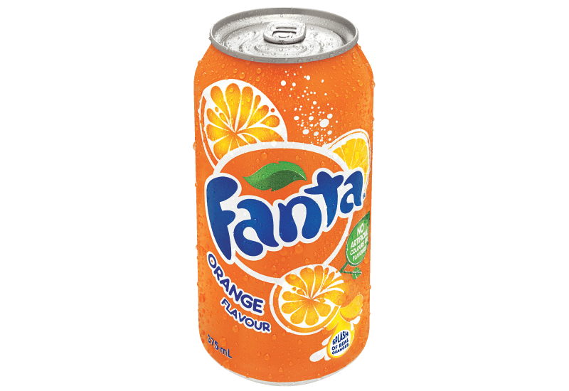
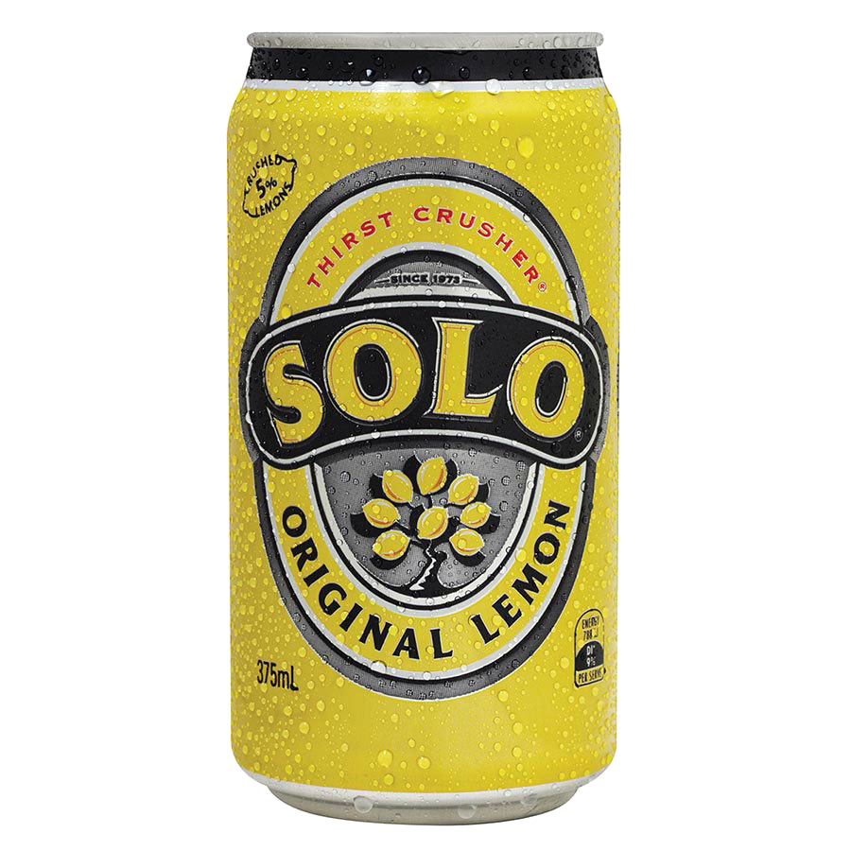
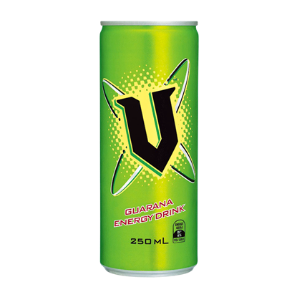
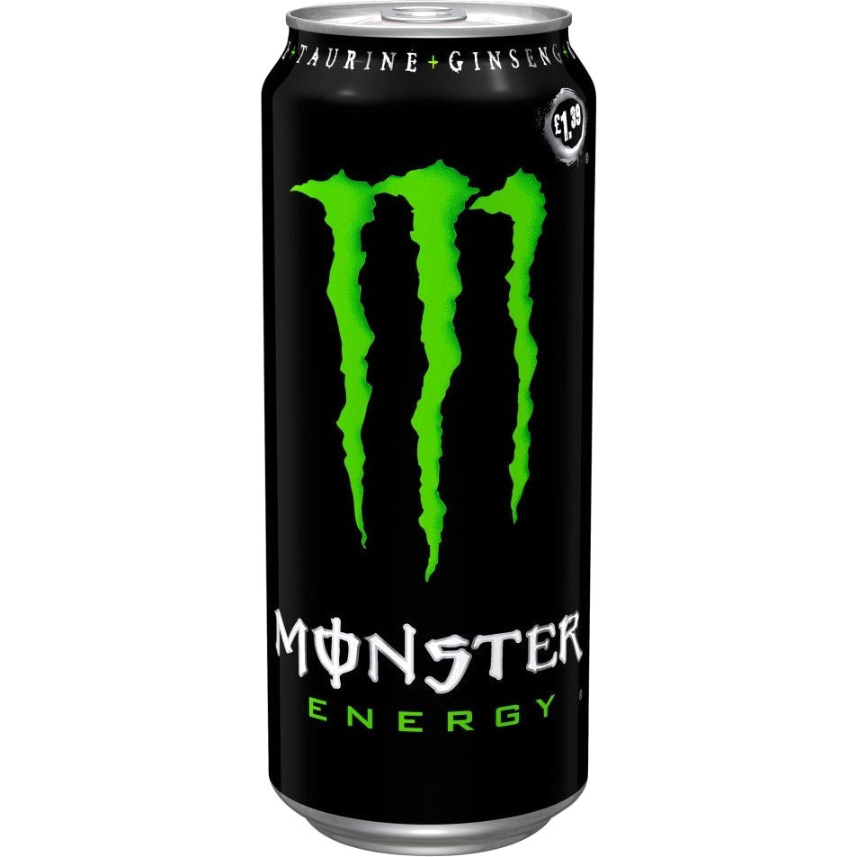
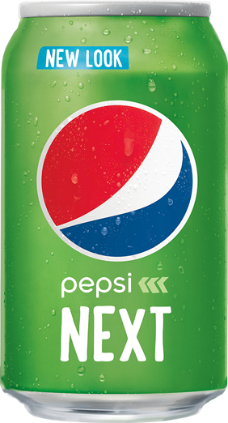
akan

Slide 3
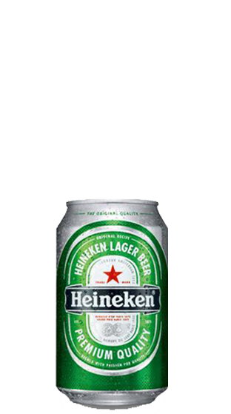
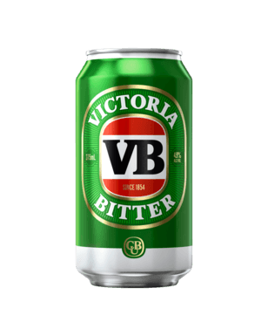
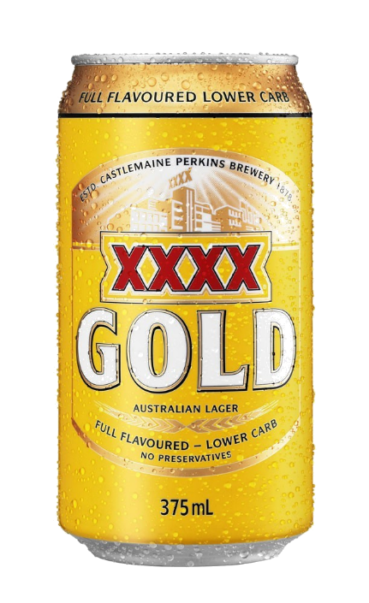
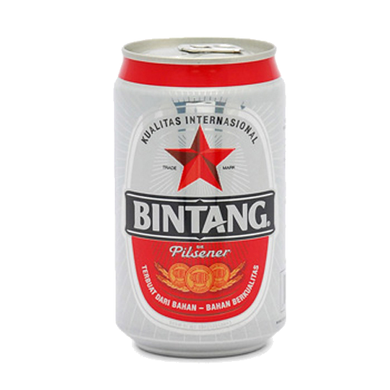
akan
By now, you’re surely thinking that “akan”, pronounced “a-kun”, must be the Indonesian word for a “canned drink”, right? The images all point to this conclusion, after all!
Unfortunately, “akan” has nothing to do with canned beverages so you may need to drown your sorrows!

Slide 4
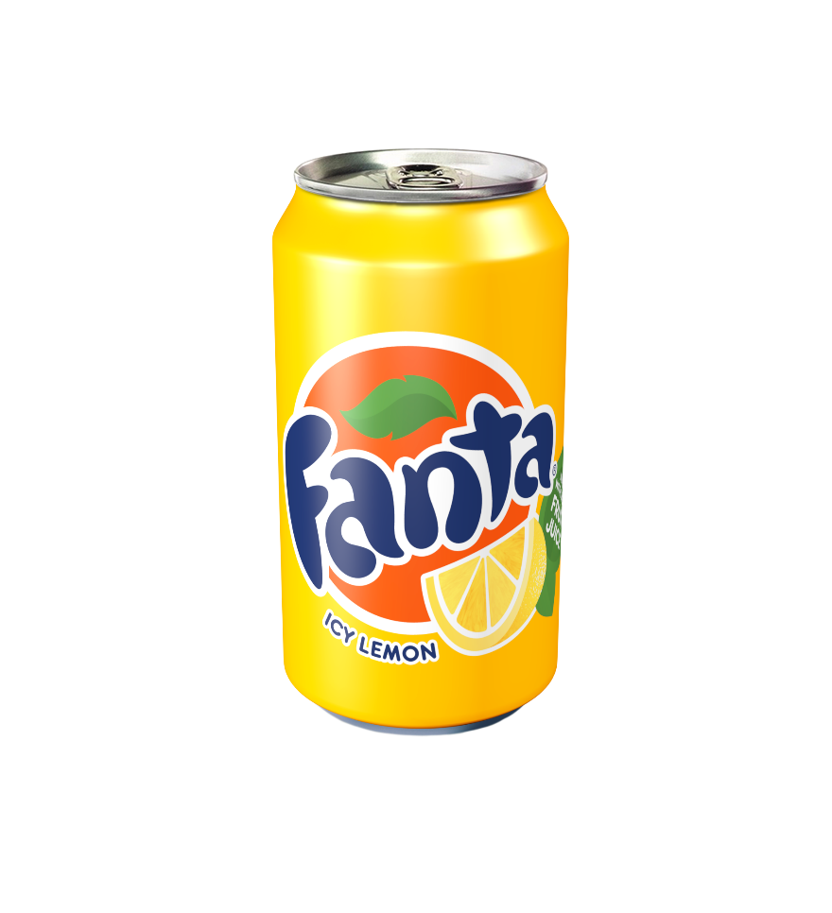
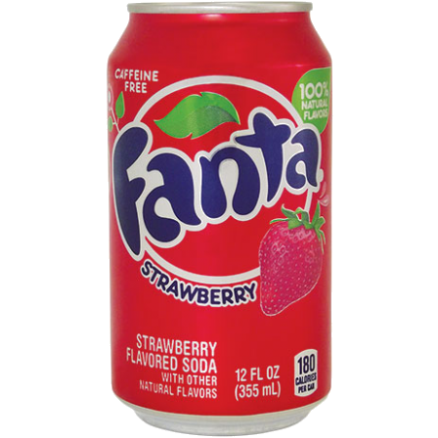
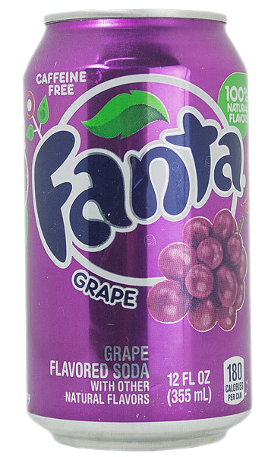
akan
The word “akan” is a tense marker for future actions and therefore means “will” in Indonesian. It is placed immediately before the verb to indicate the action “will happen” some time in the future. For example, “Saya akan minum Fanta.”

Slide 5
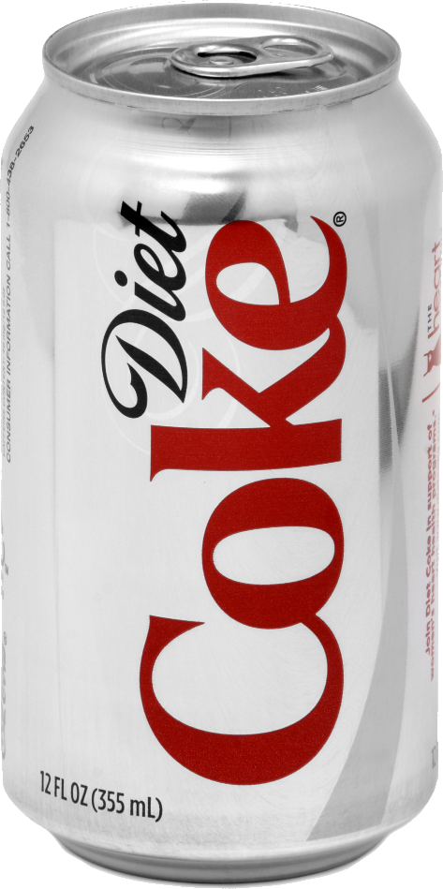
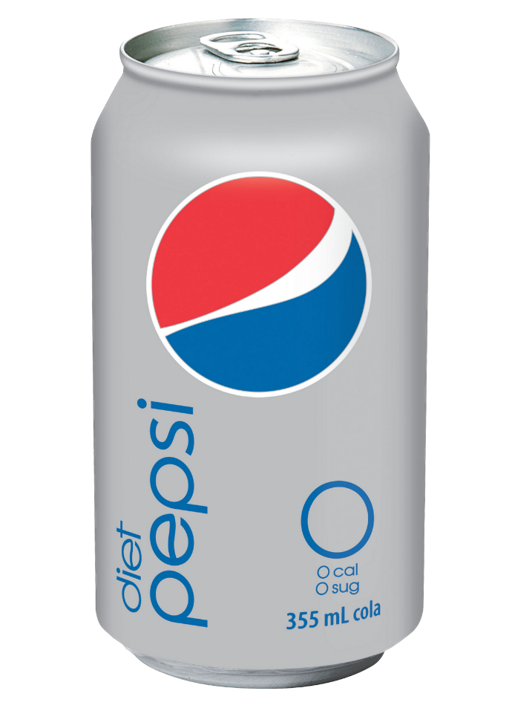
akan
Let’s all drink ‘a kan’ to celebrate the fact that we now know how to form the future tense in Indonesian … but only ‘a-kan’ of the healthy stuff !!!

