Slide 2
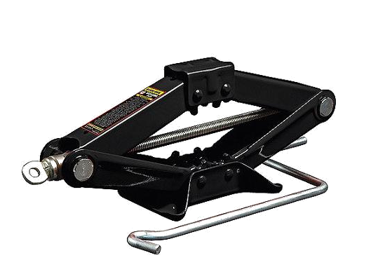
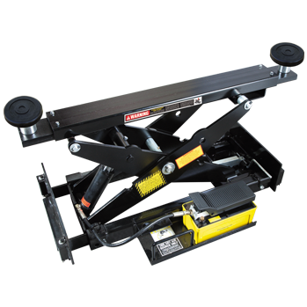
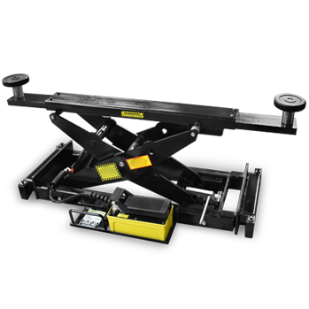
ajak

Slide 3
ajak
I know what you’re thinking … “ajak”, pronounced “ah-juck”, must be the Indonesian word for “car jack”, right?
I’d like to ‘raise’ your spirits, but I’m afraid you’re wrong again (as usual)!
The verb “ajak” means “to invite” in Indonesian.

Slide 4
ajak
I suppose if I “ajak” you to the cinema, you’ll want a ‘lift’ as well???

