Slide 2
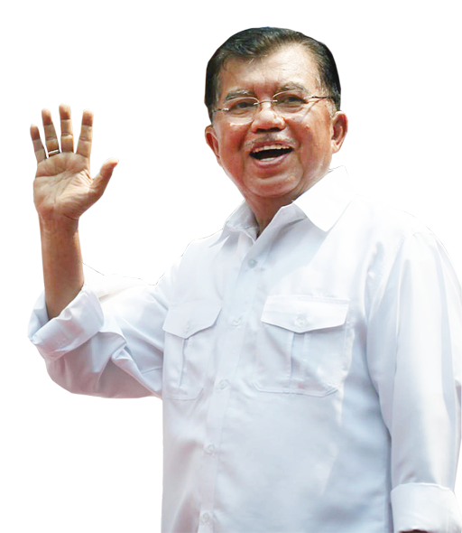
air
Welcome to America Mr
Vice-President.
Thank you Mr
Trump. I’m very happy to be here!

Slide 3
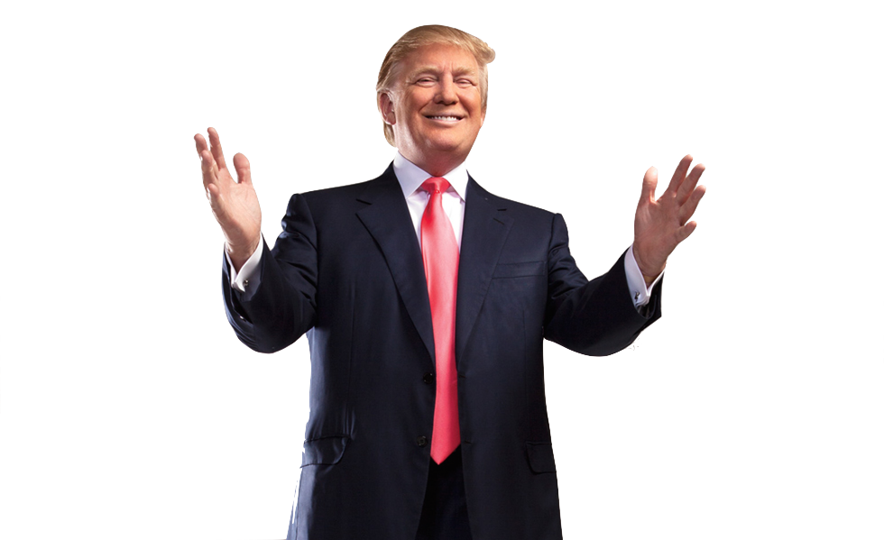
air
How have you found America so far?
I see that Bahasa Indonesia is becoming more popular here.

Slide 4
air
All your fuel outlets have their signs in both English and Indonesian!
What makes you say that?

Slide 5
air
Really? I haven’t noticed. What do you mean?
Look over there!

Slide 6
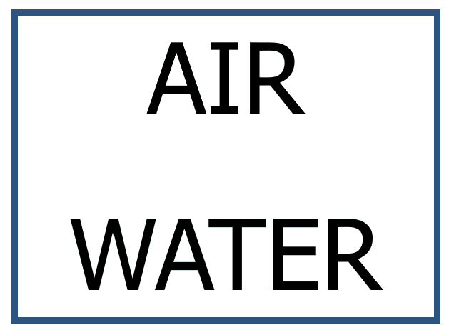

Slide 7
air
And over there!

Slide 9
air
And there, again!

Slide 10
Shell

Slide 11
air
And yet again, over there!

Slide 13
air
In Indonesian “air” means “water” so those signs are saying “Water” in both languages!
Sorry, but I still don’t understand!

Slide 14
air
Dasar goblok!!!
You know, I’ve lived here all my life and I never realised that!

