Slide 2
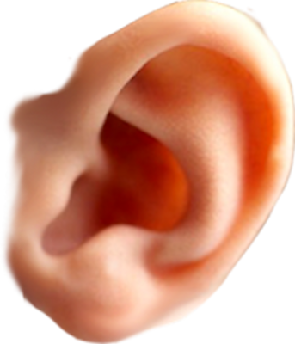
air

Slide 3
air
“air”, which means “water” must be one of the most difficult words for learners of Indonesian to master because they will invariably say “air”!
When pronounced correctly, this word will sound very similar to the words “eye” and “ear” joined together!
And that’s not just a lot of hot “air” !!!

Slide 4
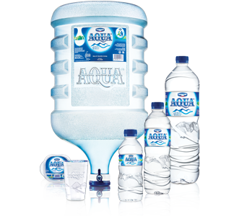
air

