Slide 2
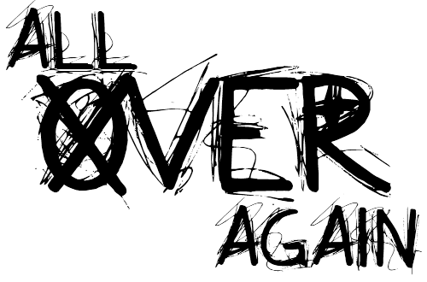
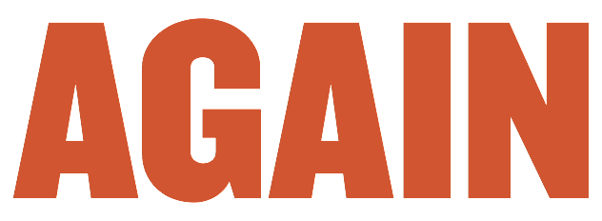
agen

Slide 3
agen
I know exactly what you’re thinking … if “agen” looks like “again”, sounds like “again” and is pronounced like “again”, then it must mean “again”, right?
Sorry to disappoint you, but you are wrong!!!
The noun “agen” actually means “agent” in Indonesian!

Slide 4
agen
Allow me to let you in on a little secret … a “secret agent” is an “agen rahasia” (pronounced “ra-ha-si-a”).
Can you keep a secret or will you spread it “agen” and “agen” ???

