Slide 2
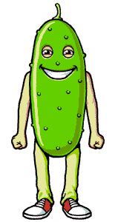
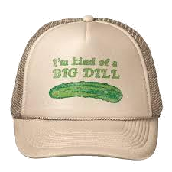
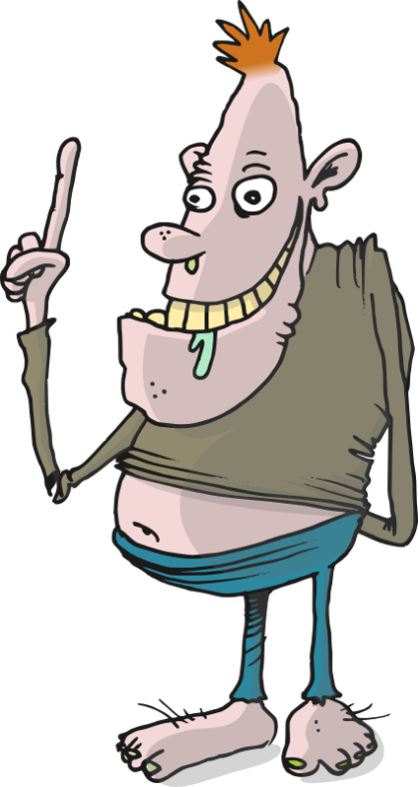
adil
Me too!!!

Slide 3
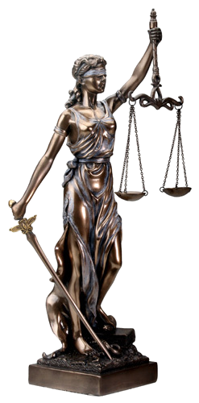
adil
I’m guessing that you think “adil” is a synonym for “goblok” which, as you have already learnt, means “idiot” in Indonesian…
If you really believe that, then you might just be a bit of “a dill”!
The adjective “adil” actually means “fair”, “just” or equitable” in Indonesian.

Slide 4
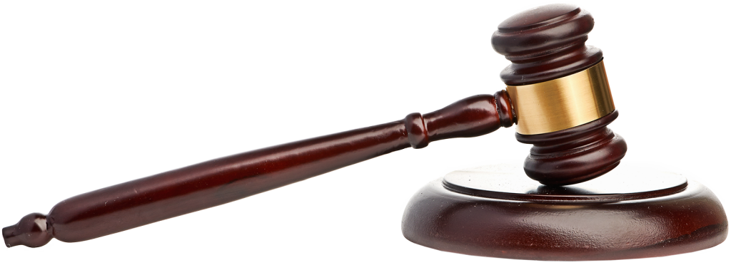
adil
Do want to be treated in an “adil” manner or do you want to be treated like “a dill” … the choice is yours!!!
We dispense swift justice here at BPSHS so ensure you make the right choices so that the scales of justice are always tipped in your favour!
Court is adjourned!

