Slide 2
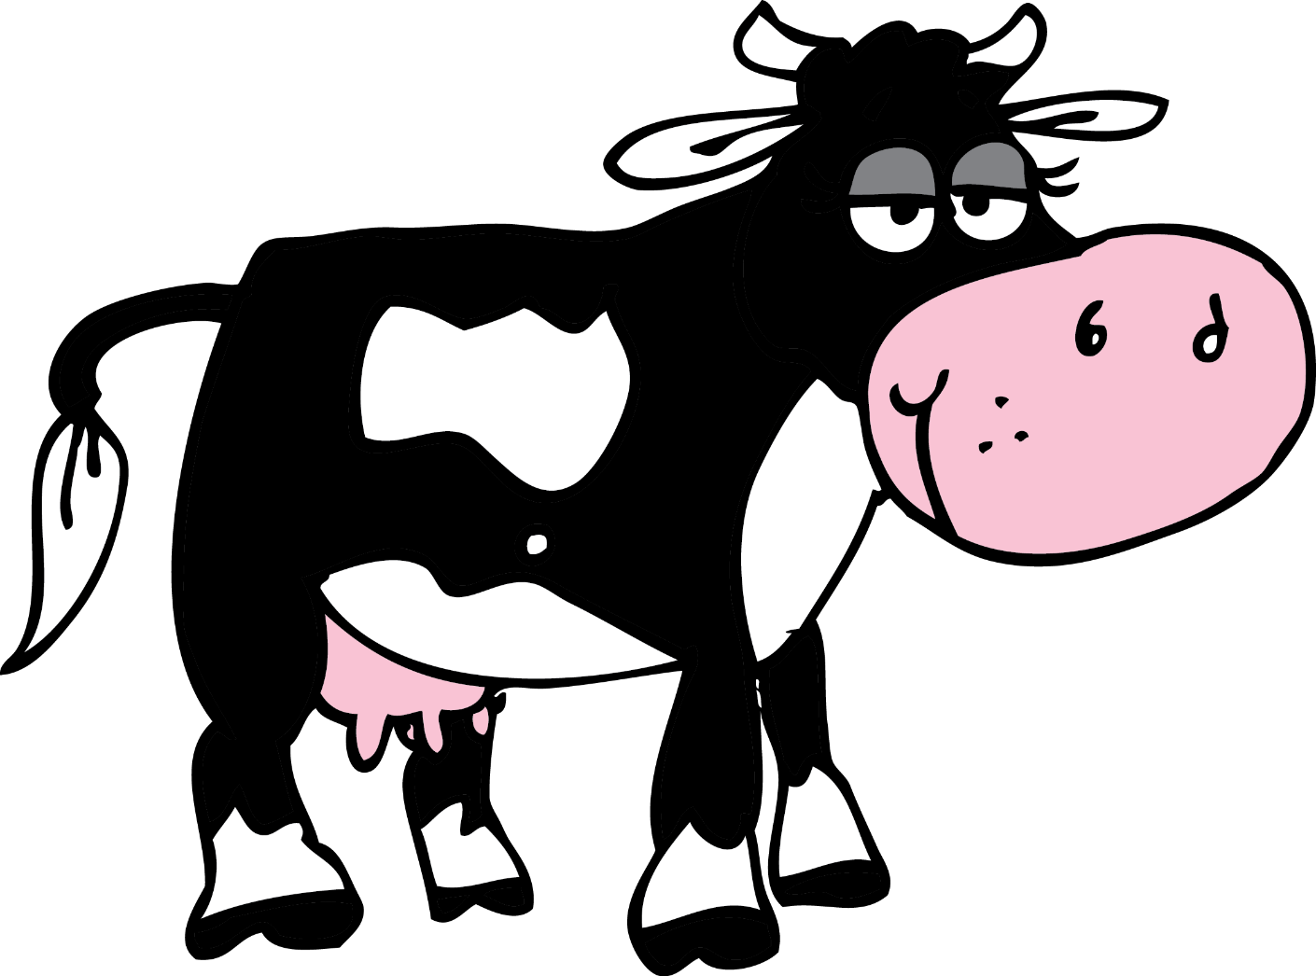
ada

Slide 3
ada
Although “ada”, is pronounced exactly the same as “udder”, it is totally different in meaning!
“ada” is possibly the most useful word in Indonesian, meaning, amongst other things, “there is” or “there are”, “to be present”, “to be located”, “to have” or “to own” and “to be in supply”.
Now, that’s no bull !

Slide 4
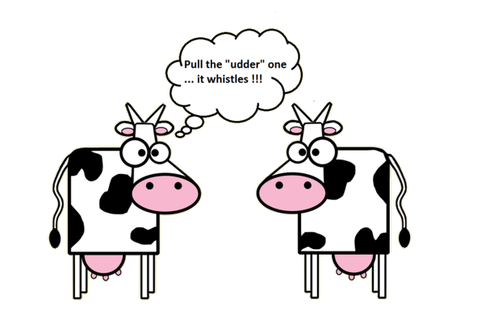
ada

